Slide 1
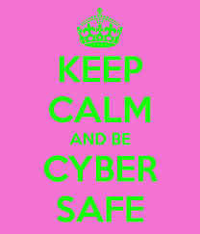
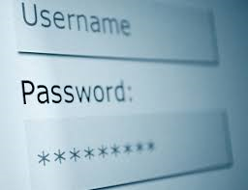
Cyber safety
And Digital Citizenship

Slide 2
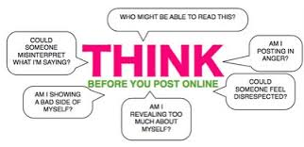
What is digital citizenship and why is it important?
Digital Citizenship is how you conduct yourself online.
As you act in regular society, you should act the same on the internet.
How you act on the internet reflects you and affects you in real life. Think before you act on the internet!

Slide 3
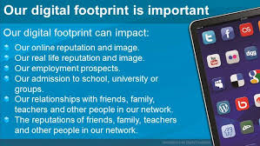
What is a digital footprint?
A digital footprint is the data that is left behind by users on digital services. There are two main classifications for digital footprints: passive and active
A passive digital footprint is created when data is collected without the owner knowing.
Active digital footprints are created when personal data is released deliberately by a user for the purpose of sharing information about oneself by means of websites or social media.

Slide 4
Cyber safety tips
Personal Information. Don’t give out personal information without your parents’ permission. This means you should not share your last name, home address, school name, or telephone number. Remember, just because someone asks for information about you does not mean you have to tell them anything about yourself!
Screen Name. When creating your screen name, do not include personal information like your last name or date of birth.
Passwords. Don’t share your password with anyone but your parents. When you use a public computer make sure you logout of the accounts you’ve accessed before leaving the terminal.
Photos. Don’t post photos or videos online without getting your parents’ permission.
Online Friends. Don’t agree to meet an online friend unless you have your parents’ permission. Unfortunately, sometimes people pretend to be people they aren't. Remember that not everything you read online is true.
Online Ads. Don’t buy anything online without talking to your parents first. Some ads may try to trick you by offering free things or telling you that you have won something as a way of collecting your personal information.
Downloading. Talk to your parents before you open an email attachment or download software. Attachments sometimes contain viruses. Never open an attachment from someone you don’t know.
Bullying. Don’t send or respond to mean or insulting messages. Tell your parents if you receive one. If something happens online that makes you feel uncomfortable, talk to your parents or to a teacher at school.
Social Networking. Many social networking websites (e.g., Facebook, Twitter, Second Life and MySpace) and blog hosting websites have minimum age requirements to signup. These requirements are there to protect you!
Research. Talk to your librarian, teacher or parent about safe and accurate websites for research. The public library offers lots of resources. If you use online information in a school project make sure you explain where you got the information.

Slide 5
Cyber bullying and why it is dangerous
In all its forms, cyberbullying combines the devastating effects of in-person bullying with several added issues unique to its technological format. These factors magnify the feelings of shame and helplessness that the victims experience as a result of any type of bullying.
Anonymity--You can be cyberbullied by a stranger or a close acquaintance without ever being able to tell who the culprit is. Bullies may feel empowered to say and do more destructive things than they would face-to-face when they are interacting with their victims screen-to-screen.
Permanence--It can be nearly impossible to rid the internet of offensive material that a cyberbully makes public; once a photo, rumor, or video has made it into a cyberspace, it may be there forever.
Publicity--Cyberbullying can escalate what might once have been schoolyard disputes into smear campaigns accessible to the whole world. All it takes is for a “friend” to forward an email to friends who forward it further or to re-post or re-tweet a bullying for the bullying to “go viral” and reach a large audience.
Omnipresence—Cyberbullying follows you home. A student being bullied at school may find refuge in other spaces, but a victim of cyberbullying is connected to his or her tormentors whenever he or she is connected to a cell phone or computer—which for many teens is all the time.

Slide 6
Resource Links for parents
http://www.netsmartz.org/Predators National Center for Missing and Exploited Children website with valuable information and activities for you and your children
http://www.safekids.com This website has recent articles and Blogs along with safety advice and guides. There are also resources for youth in crisis along with a valuable video library
http://www.isafe.org Helpful tabs for parents and students along with valuable webinars
http://www.internetsafety.com this website provides internet safety filters for your home computer
http://enough.org Enough Is Enough® (EIE), a non-partisan, 501(c)(3) non-profit organization, emerged in 1994 as the national leader on the front lines to make the Internet safer for children and families. Since then, EIE has pioneered and led the effort to confront online pornography, child pornography, child stalking and sexual predation with innovative initiatives and effective communications.
http://www.internetsafety101.org/agebasedguidlines.htm Aged based guideline resource for internet safety

Slide 7
Cyber safety tips for parents
Internet Safety's 5 Tips for Creating a Cybersafe Home™
This generation of parents is the first to face the challenge of helping our children make the most of their virtual space while keeping them safe in it. If you’re still getting your footing in virtual parenting, don’t worry. InternetSafety.com has the following tips to help ensure that your child’s online experience remains positive.
1. Become a net-savvy parent
The best safeguard against online dangers is being informed. Jump in and learn the basics of the Internet—read articles, take a class, and talk to other parents. A good place to start with some basics is www.LearnTheNet.com. A good place to stay current with the latest in online technology is mashable.com. You don’t have to be an expert to have a handle on your child’s online world.
2. "Chat" with your kids
Develop an open dialogue so that you can talk with your kids about the benefits and dangers of the Internet. Cultivate an interest in their online activities—their favorite Web sites, online games, and interests. And don’t be afraid to ask your children who they are talking to online and what they are talking about.
3. Agree on a game plan
Use the InternetSafety.com Gameplan™ to formally agree on your family’s guidelines for using the Internet. Post them near the family computer as a reminder. Ensure that your kids know to never share personal information on the Internet and that they should tell you about any online activity or contact that makes them uncomfortable.
4. Protect your computer
Take advantage of the software that exists to help parents manage their children’s computer experience. In only a few minutes, parental control software like Safe Eyes can block inappropriate websites, restrict the amount of time that your kids use the Internet and monitor their Instant Messenger chats to protect against predators.
5. Explore the Internet as a family
With a game plan and a protected computer, you can now encourage your family to take advantage of all that the Internet has to offer. Take a genuine interest in what your kids are doing and stay engaged with them online.

Slide 8
Resource links for students
VIDEOS
http://www.cybersmart.gov.au/Kids/Watch%20Videos/net-basics.aspx Check out this link for videos on internet safety
https://jr.brainpop.com/artsandtechnology/technology/internetsafety/ Check out the Brainpop website for more videos on internet safety
GAMES
https://sos.fbi.gov/ FBI Cyber Surf Island: Travel to an island and learn how to stay safe online, including protecting your information, cell phone safety and more. (Flash required)
http://www.nsteens.org/Games Learn about what information should not be included in your online profiles. Players help Tad clean up his messy profile by collecting the information that should be kept private while avoiding others who would dispense Tad's personal information all over school.

